Slide 1
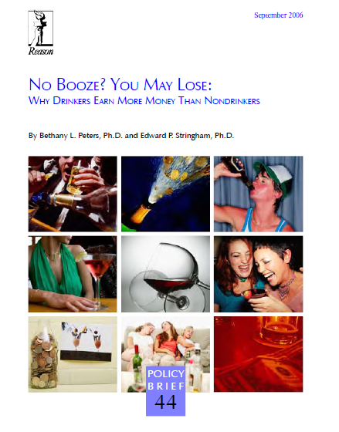
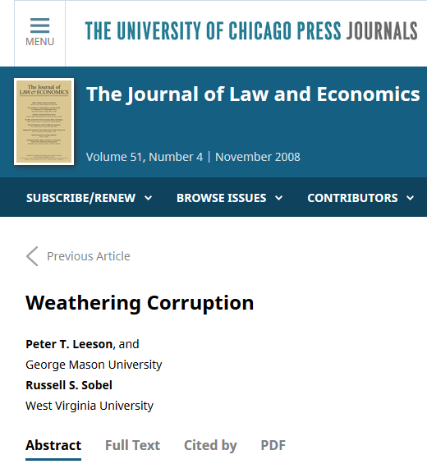
Solution to HW06

Slide 2

Households in the United States

Slide 3
In 2016, μ = 2.53, σ = 1.70
Q1. If n = 171 households are chosen at random, what is P(2.43 <  < 2.65)?
E() = 2.53
SE() = 1.70 / sqrt(171) = 0.13
n is large, so use normal curve
→ P(2.43 <  < 2.65) = P(–0.769 < Z < 0.923) = 0.601

Slide 4
In 2016, μ = 2.53, σ = 1.70
Q2. If n = 3 households are chosen at random, what is P(2.43 <  < 2.65)?
If 2.43 <  < 2.65 and n = 3, then the total number of people in the sample is between 2.43*3 = 7.29 and 2.65*3 = 7.95
How likely is it that the sample will contain between 7.29 and 7.95 people?
(REMINDER: THE CENTRAL LIMIT THEOREM ONLY APPLIES WHEN THE SAMPLE SIZE IS LARGE!)

Slide 5
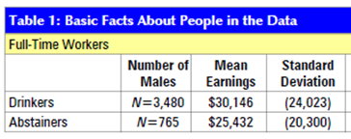
“No Booze, You May Lose”
Q3: male drinkers v. male abstainers
Are pop. μ’s same?

Slide 6
H₀: μ_{drinker} = μ_{abstainer}
If assume σ’s same,
s_{pool} = 23396
SE = 934
T = (4714–0) / 934 = 5.0
If assume σ’s differ,
SE = 839
T = (4714–0) / 839 = 5.6
Reject H₀
Q3: male drinkers v. male abstainers
Are pop. μ’s same?
Are we testing that drinkers and abstainer incomes come from the same (single) pool of values, or are we asking if the means are equal, regardless of SD?

Slide 7
“No Booze, You May Lose”
Q4: valid conclusions?
The average earnings for the population of female drinkers is higher than the average earnings for the population of female abstainers
The average earnings for the population of female drinkers could be the same as the average earnings for the population of female abstainers
The average earnings for the population of female drinkers is definitely the same as the average earnings for the population of female abstainers
If an abstainer female were to begin drinking, the expected value of the increase in her annual income would be $2387 to $4080 (95% confidence).
Both A and D are correct.

Slide 8
“No Booze, You May Lose”
Q5: rate of poverty?
Do earnings have a normal distribution?
Answer: Can not be determined from the information!
Not every question can be answered!

Slide 9
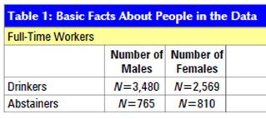
“No Booze, You May Lose”
Q6: rate of drinkers, male v. female?
This is a test of proportions …

Slide 10
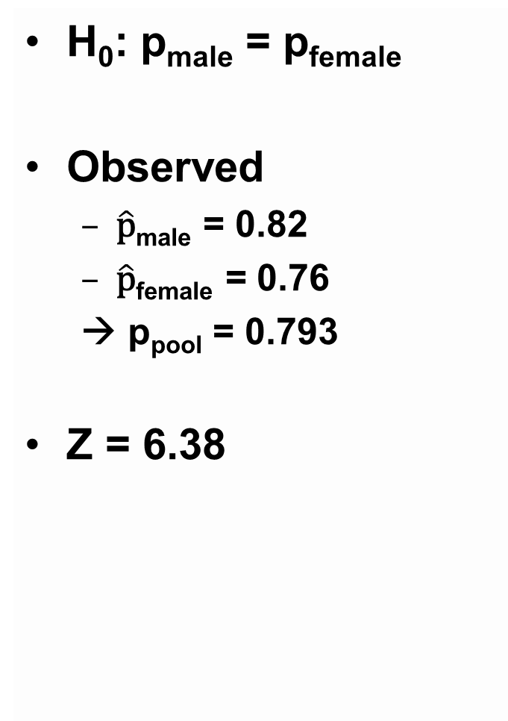
H₀: p_{male} = p_{female}
Observed
$\hat{\text{p}}$_{male} = 0.82
$\hat{\text{p}}$_{female} = 0.76
→ p_{pool} = 0.793
Z = 6.38
Q6: rate of drinkers, male v. female?
This is a test of proportions …

Slide 11
Q7: 95% CI for California?
This is a question about averages, not percentages
“Weathering Corruption”

Slide 12
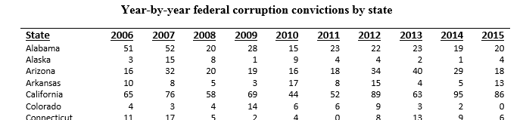

95% CI for rate in California:
157,000 federal employees in California …
=0.444, s=0.106, SE()=s/sqrt(10)= 0.0335, T₉ = 2.262 → 95% CI: 0.444 + (2.262)(0.0335)

Slide 13
Q8: avg corruption rate by FEMA $
H₀: μ_{<75M} = μ_{>75M}
If assume σ’s equal, s_{pool} = 0.332, SE = 0.093, T = 3.38
If assume σ’s differ, SE = 0.094, T = 3.35
“Weathering Corruption”
FEMA: | n | avg | SD
<$75M | 26 | 0.421 | 0.262
>$75M | 25 | 0.736 | 0.392

Slide 14
Q9: odds ratio …
“>$75M” put on top since it has higher odds
OR = (17*18)/(8*8) = 4.78
SE = sqrt(1/17 + 1/8 + 1/8 + 1/18) = 0.604
→ 95% confidence interval:
4.78*exp(–1.96*0.604) = 1.46 to
4.78*exp(+1.96*0.604) = 15.61
“Weathering Corruption”
 | Rate > 0.5 | Rate < 0.5
>$75M | 17 | 8
<$75M | 8 | 18

Slide 15
States that received more FEMA dollars had more convictions due to corruption
Does this show that FEMA causes corruption, and that “eliminating FEMA disaster relief would reduce corruption more than 20 percent in the average state”?
“Weathering Corruption”

Slide 16
Q10: conclusions?
If the 25 states that received more than $75M from FEMA had not received money from FEMA, their average conviction rate due to corruption would have been about 0.42 / 0.74 = 57% of its current rate.
The population of states that received more than $75M from FEMA had a higher average rate of conviction due to corruption than the population of states that received less than $75M from FEMA.
The population of states that received more than $75M from FEMA might have the same average rate of conviction due to corruption as the population of states that received less than $75M from FEMA.
If the 25 states plus DC that received less than $75M from FEMA had been given more than $75M from FEMA, their expected conviction rate due to corruption would be 0.74 or so.
A, B, and D are correct.
“Weathering Corruption”

Slide 17
Questions on HW06?
Some real world lessons:
Not everything in print is true/correct
Not everything in print is wrong
Never blindly trust a PhD … think for your self
Never trust a PhD

Slide 18
Remark: note that final is on 12/12, not 12/9
This has been posted to Facebook as well

